Slide 1
Sample Paper
ST1002

Slide 2
1a. Why is it important to know the type of data (categorical or quantitative)?
Type of data will dictate what we can do with it
Graphs we can draw
Summary statistics
Type of analyses
Histogram – 1 quantitative variable
Categorical data – frequency tables

Slide 3
Two groups compared on affluence score
Mid line median; lower box line 25th ile; upper box line 75th ile
* Outliers : judged on distance from upper and lower box

Slide 4
1c. Mean vs Median
Measure of the center of the distribution
Mean: average of all obs.
Median : middle obs.
Skewed distributions will result in different values for each

Slide 5
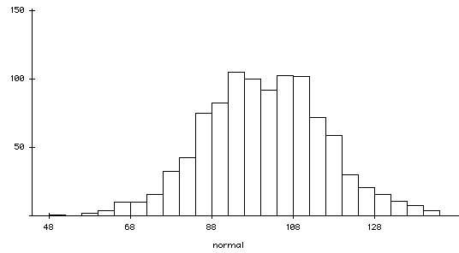
Mean=median=100.8

Slide 6
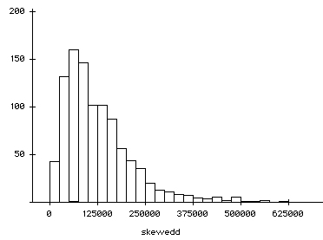
Mean=1276; median=1049

Slide 7
1d. Compare the range and the standard deviation as measures of variability
Range easy to understand
Depends only two values highest and lowest
Can be influenced by outliers
Standard deviation uses all the data
Used with mean
Nice interpretation when variable is normally distributed

Slide 8
1e. What percentage of notes would you expect in the interval 137 to 144mm?
Normally distribution
Mean=141mm;SD=2.5mm
Draw a graph
And then calculate area

Slide 9
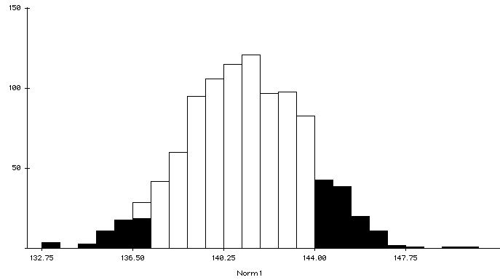
1- [P(x<137) + P(x>144)]
Take each separately

Slide 10
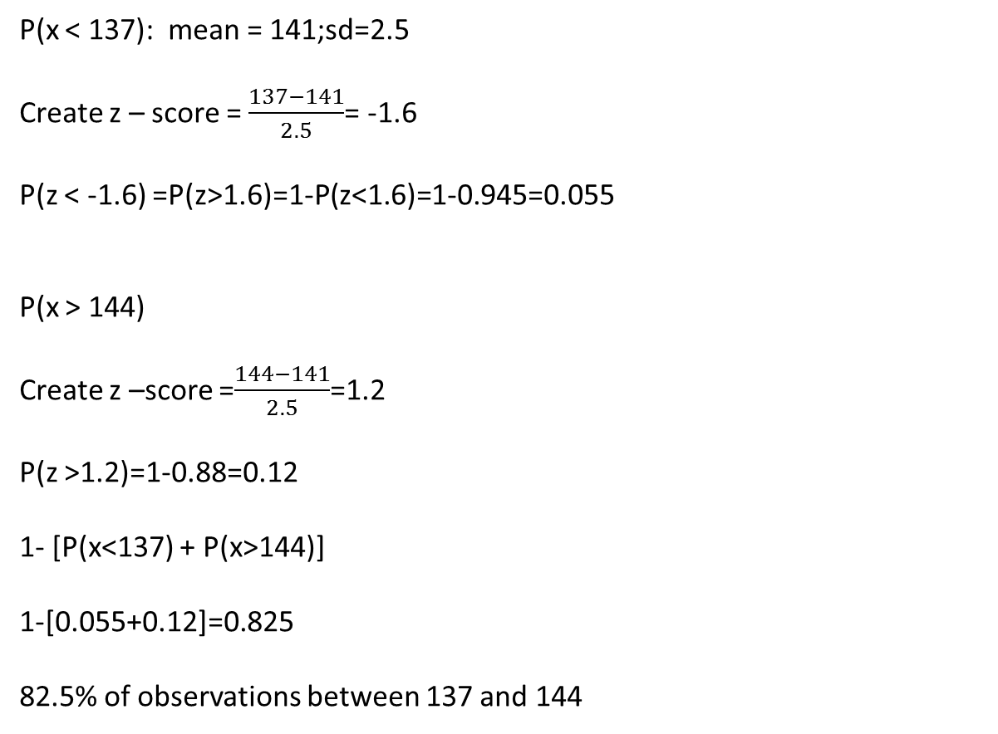
P(x < 137): mean = 141;sd=2.5
Create z – score = $\frac{137−141}{2.5}$= -1.6
P(z < -1.6) =P(z>1.6)=1-P(z<1.6)=1-0.945=0.055
P(x > 144)
Create z –score =$\frac{144−141}{2.5}$=1.2
P(z >1.2)=1-0.88=0.12
1- [P(x<137) + P(x>144)]
1-[0.055+0.12]=0.825
82.5% of observations between 137 and 144

Slide 11
Rows: Buy Organic Columns: GENDER
F M All
No 296 172 468
322.8 145.2 468.0
yes 153 30 183
126.2 56.8 183.0
All 449 202 651
449.0 202.0 651.0
Cell Contents: Count
Expected count

Slide 12
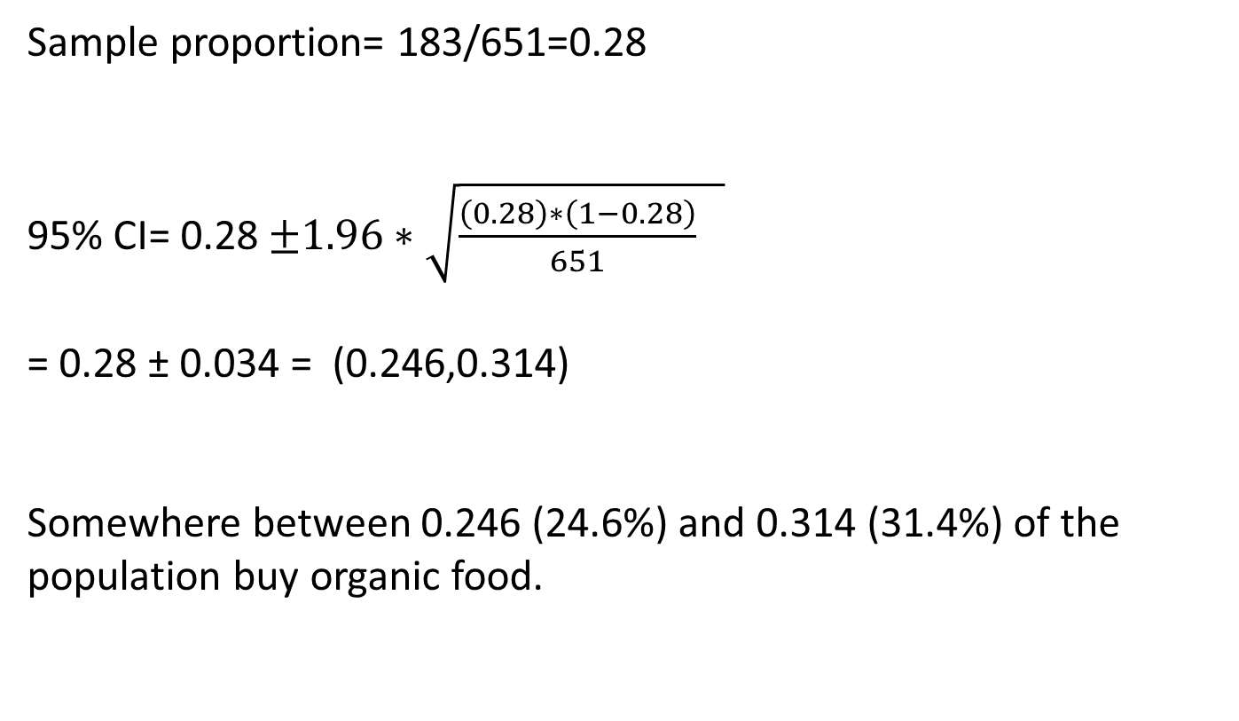
Give a 95% confidence interval for the proportion of people who purchased organic food. Explain what it means.
Sample proportion= 183/651=0.28
95% CI= 0.28 $±1.96∗\sqrt{\frac{\left(0.28\right)∗\left(1−0.28\right)}{651} }$
= 0.28 ± 0.034 = (0.246,0.314)
Somewhere between 0.246 (24.6%) and 0.314 (31.4%) of the population buy organic food.

Slide 13
Null hypothesis
H₀: There is no relationship (association) between gender and purchase of organic food in the population
or
H₀: The proportion of males and females who buy organic food is the same in the population.

Slide 14
Alternate hypothesis
H₀: There is a relationship (association) between gender and purchase of organic food in the population
or
H₀: The proportion of males and females who buy organic food is not the same in the population.

Slide 15
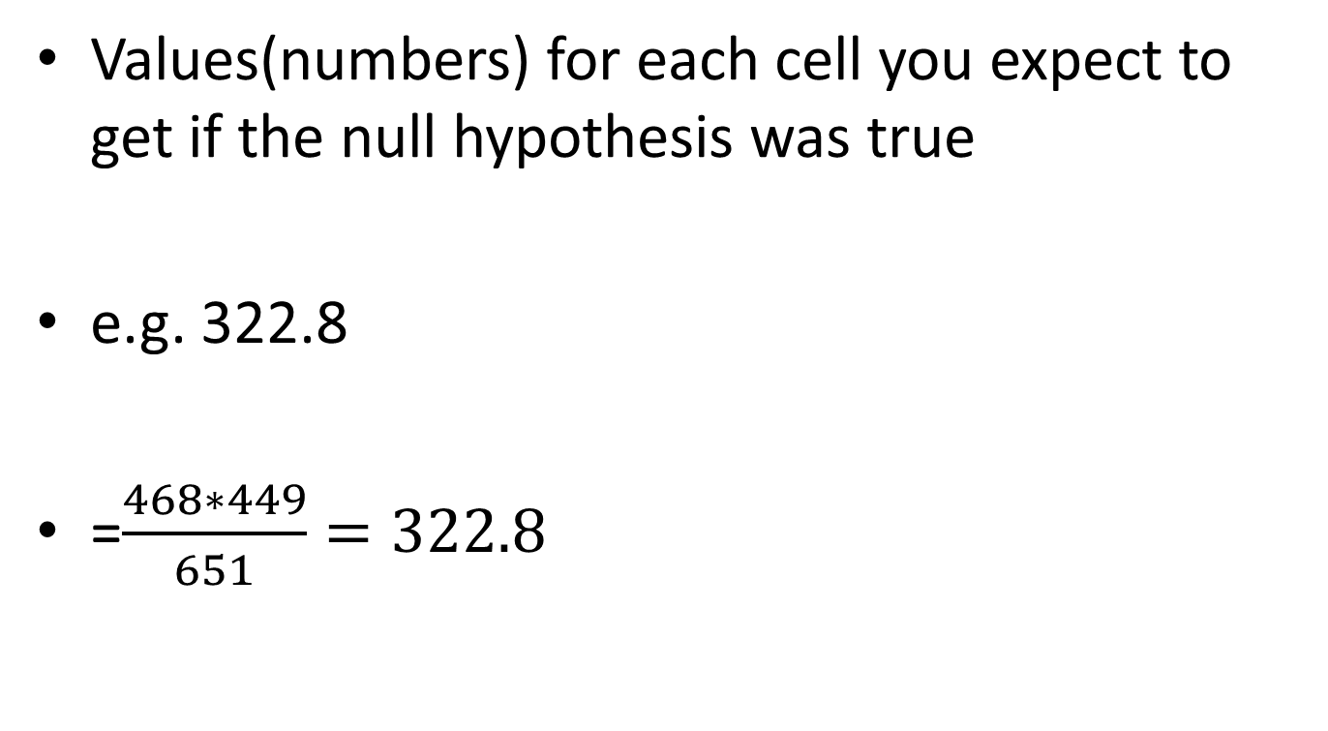
What are the Expected values (italicised numbers) in the table?.
Values(numbers) for each cell you expect to get if the null hypothesis was true
e.g. 322.8
=$\frac{468∗449}{651}=322.8$

Slide 16
Pearson Chi-Square = 25.479, DF = 1, P-Value = 0.000
Pearson Chi-square calculated from formula
df =1 = no. of rows -1 * no. of columns -1=1
p <0.05
We can conclude we have evidence against the null hypothesis
Therefore there is an association between gender and purchase of organic food in the populations

Slide 17
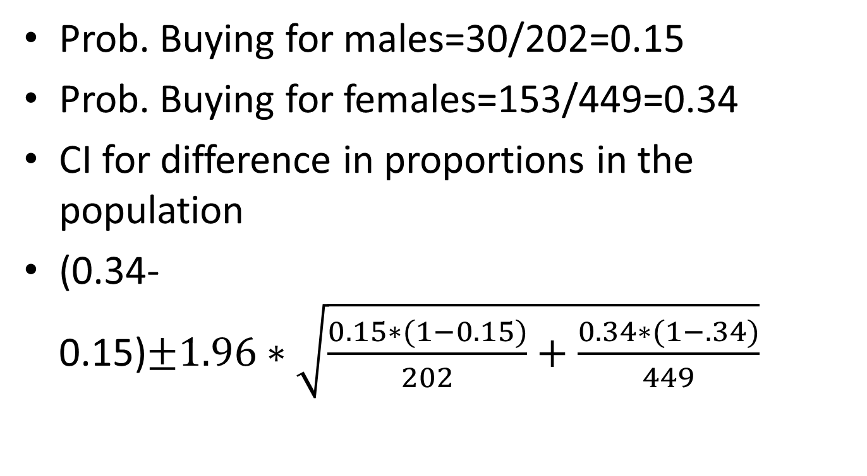
Confidence interval
Prob. Buying for males=30/202=0.15
Prob. Buying for females=153/449=0.34
CI for difference in proportions in the population
(0.34-0.15)$±1.96∗\sqrt{\frac{0.15∗(1−0.15)}{202}+\frac{0.34∗(1−.34)}{449}}$

Slide 19
Q3b. SE of mean
SE of mean = measure of the variability of the mean from sample to sample

Slide 20
Systematic sample
Take every nth person from a list
Describe how you would select a systematic sample of 35 people from a population of 1136 people
K=1136/35=32 rounded
Take a random number between 1 and 1136
Say 750
Pick 750, 750+32, 750+2*32 etc. and wrapping round at the end

Slide 21
Numbers selected
750
782
814
846
878
910
942
974
1006
1038
1070
1102
1134
1166 | 30

Slide 22
Two-Sample T-Test and CI: Diagonal, Status
Two-sample T for Diagonal
Status N Mean StDev SE Mean
Not Fraud 100 141.517 0.447 0.045
Fraudulent 100 139.450 0.558 0.056
Difference = mu (0) - mu (1)
Estimate for difference: 2.0670
95% CI for difference: (1.9260, 2.2080)
T-Test of difference = 0 (vs not =): T-Value = 28.91 P-Value = 0.000 DF = 198

Slide 23
Explanation
Summary statistics for the two groups 0 and 1
We are interested in comparing the two population means
T-test does this
H_{0 :} Difference between population means=0
H₁: Difference between population means≠0
Estimate for difference: 2.0670 in population means
95% CI for difference of populations means : (1.9260, 2.2080)

Slide 24
And more…
T-Test of difference = 0 (vs not =): T-Value = 28.91 P-Value = 0.000 DF = 198
Since p< 0.05 we have evidence against the null hypothesis
Estimate of difference in the population =95% CI for difference: (1.9260, 2.2080)
Average Diagonal of Not fraudulent banknotes is between 1.93 and 2.21 mms shorter than fraudulent banknotes

Slide 25
As temperature increases so does yield
Note the range of the temperature variable

Slide 26
The regression equation is
Yield gms = 17.0 + 2.00 Temp C
Predictor Coef SE Coef T P
Constant 17.002 4.072 4.18 0.000
Temp C 1.99517 0.05334 37.41 0.000
S = 4.01967 R-Sq = 98.4% R-Sq(adj) = 98.3%

Slide 27
Yield gms = 17.0 + 2.00 Temp C
17.0 is estimated yield in gms for 0 ⁰ C – we may not interested in this value since it is outside of the range of the temp.
2.00 is the estimated increase in yield when temperature is increased by 1⁰ C
95% CI for this estimated increase in yield when temperature is increased by 1⁰ C is 2 ±1.96*0.05 (approx)
R-sq=98.4 % measure of fit of model to data – very good
S=4.02 – sd of residuals

Slide 28
Predictor Coef SE Coef T P
Constant 17.002 4.072 4.18 0.000
Temp C 1.99517 0.05334 37.41 0.000
T- value of 37.41 tests whether the population slope is =0 or not.
Huge value
Enough evidence to reject this hypothesis and conclude that there is a linear relationship between temperature and yield
We are not interested in t-test associated with Constant.
Theoretically it is testing whether the population constant/intercept=0

Slide 29
Using the above results show how to predict the yield for a temperature of 75.
Yield gms = 17.0 + 2.00 Temp C
= 17.0+2*75 = 167 grms
Is it within the bounds of the data?

